Slide 1

Introduction
to
Computer Science
CS101.3
Lecture #12
Pramudya Thilakaratne pramudya.h@nsbm.ac.lk
Lecturer
Faculty of Computing
NSBM Green University

Slide 2
Welcome to Lecture 12!
Take your notebooks and prepare
You can ask questions via either chat message or over the mic.
When you are not using the mic please mute it.

Slide 3

From Last Week
Image Representation

Slide 4
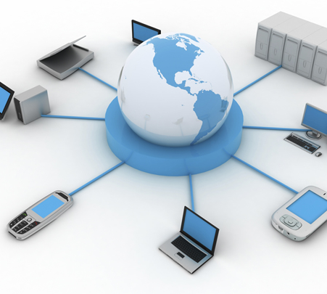
Computer Networks

Slide 5
Computer Network
A network is the interconnection of set of devices capable of communication where devices are connected via transmission media.
A device can be,
A host (an end system) - such as a large computer, desktop, laptop, workstation, cellular phone or security system
A Connecting device – such as a router (connects networks to other networks), a switch (connects devices together), a modem (modulator- demodulator)

Slide 6
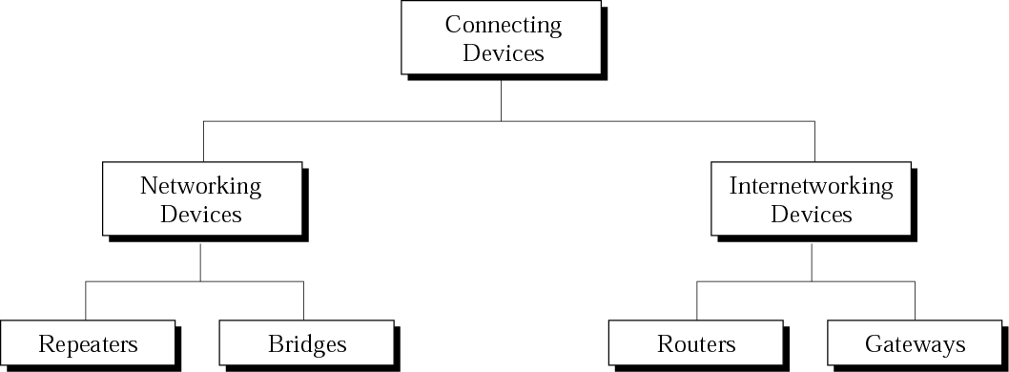
Connecting Devices

Slide 7
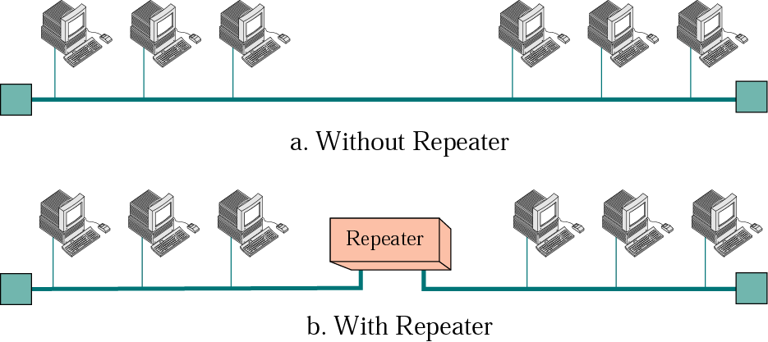
Repeater
Regenerates the original signal where it used to extend the physical length of a network.

Slide 8
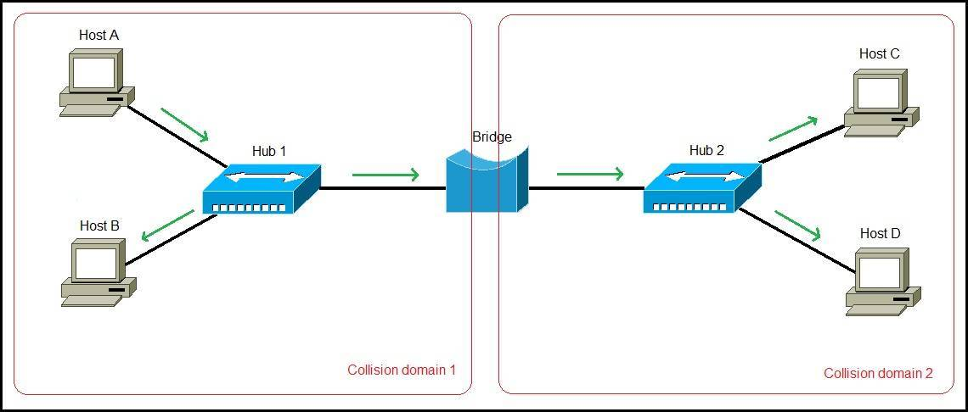
Bridge
A bridge in a computer network is one kind of network device, used to separate a network into sections.
Bridge also used as a traffic controller.

Slide 9
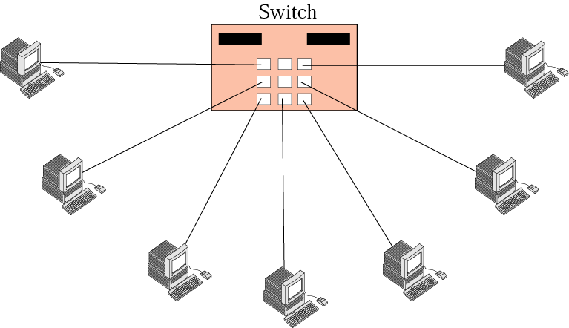
Switch
A switch is device which capable of connecting number of devices where it can used to expand the network.

Slide 10
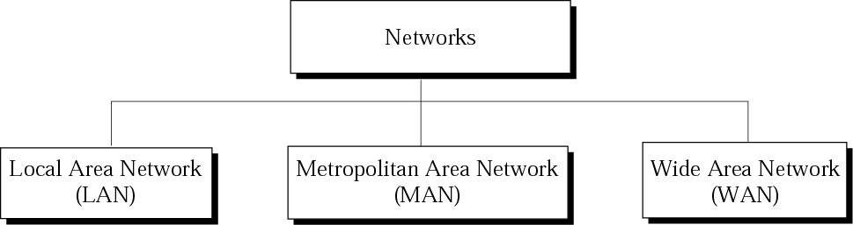
Categories of Networks

Slide 11
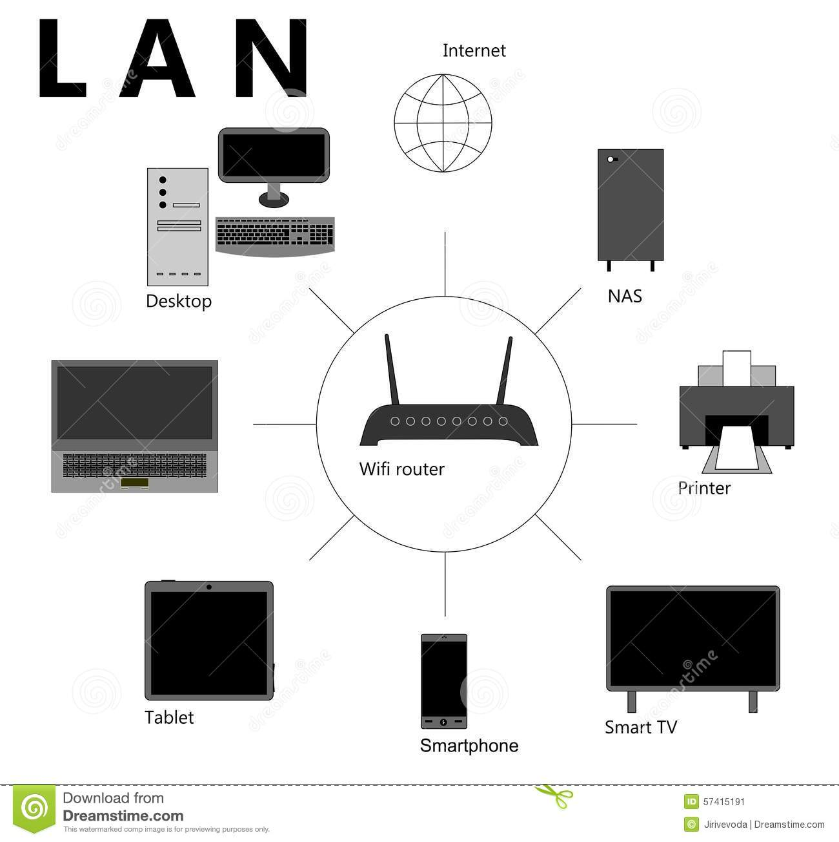
LAN (Local Area Network)
A local area network is a computer network that interconnects computers within a limited area such as a residence, school, laboratory, university campus or office building.
LAN allows resource sharing between computers
Computers
Printers
Scanners

Slide 12
LAN (Local Area Network)
Physical Topology
This is the physical layout of a network. Two or more devices connect to a link.
The geometric relationship between the links and linking devices (called nodes) is the topology
There are four basic topologies
Mesh Topology
Star Topology
Bus Topology
Ring Topology

Slide 13
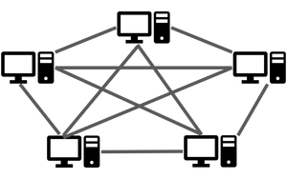
LAN (Local Area Network)
Physical Topology
Mesh Topology
Every device has a dedicated point to point link with every other device.

Slide 14
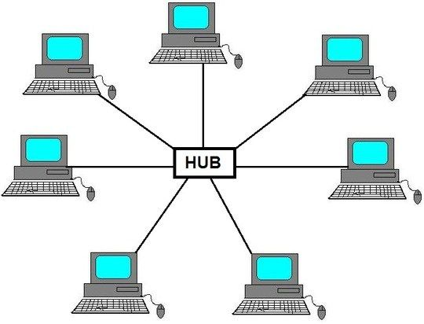
LAN (Local Area Network)
Physical Topology
02. Star Topology
Each device has a point-to-point dedicated connection to a central controller called hub.
The controller act as an exchange

Slide 15
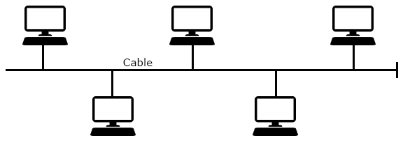
LAN (Local Area Network)
Physical Topology
03. Bus Topology
A multipoint connection where a single cable (called a backbone) runs through linking all the devices

Slide 16
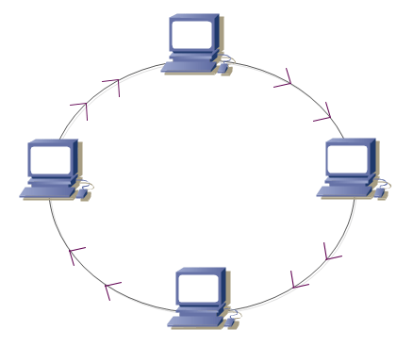
LAN (Local Area Network)
Physical Topology
04. Ring Topology
Each device has a dedicated point to point connection with the two devices on either side of the ring
Signals only travels in one direction (Clockwise or Anti- clockwise)
When a device receives a signal intended for another device, it simply regenerates it and passes it to the next device

Slide 17
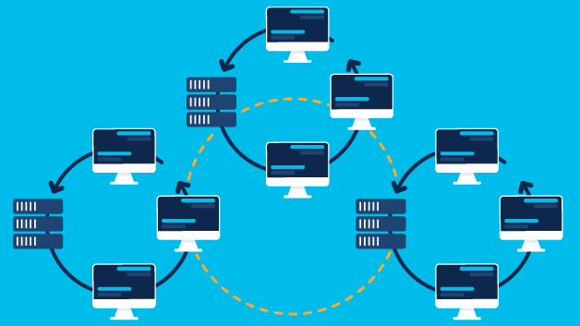
WAN (Wide Area Network)
As the name suggest a WAN spans a wide geographical area.
e.g. – a town, a state, a country or even the world.
A WAN interconnects connecting devices such as switches, routers or modems.

Slide 18
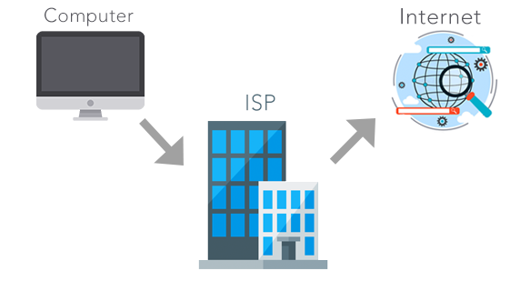
The Internet
The internet is composed of thousands of networks which connected through Internet Service Providers (ISPs).

Slide 19

What is World Wide Web (WWW)
The World Wide Web (WWW) is a system of Internet servers that support specially formatted documents.
The documents are formatted in a markup language called HTML (Hyper Text Markup Language) that supports links to other documents, as well as graphics, audio and video files.

Slide 20
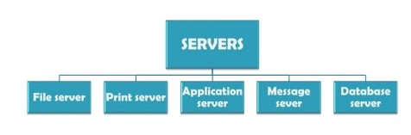
What is a Server
A Server is a computer that provides data to other computers.
It may serve data to systems in Local Area Networks (LANs) or Wide Area Networks (WANs) over the internet.

